Slide 1
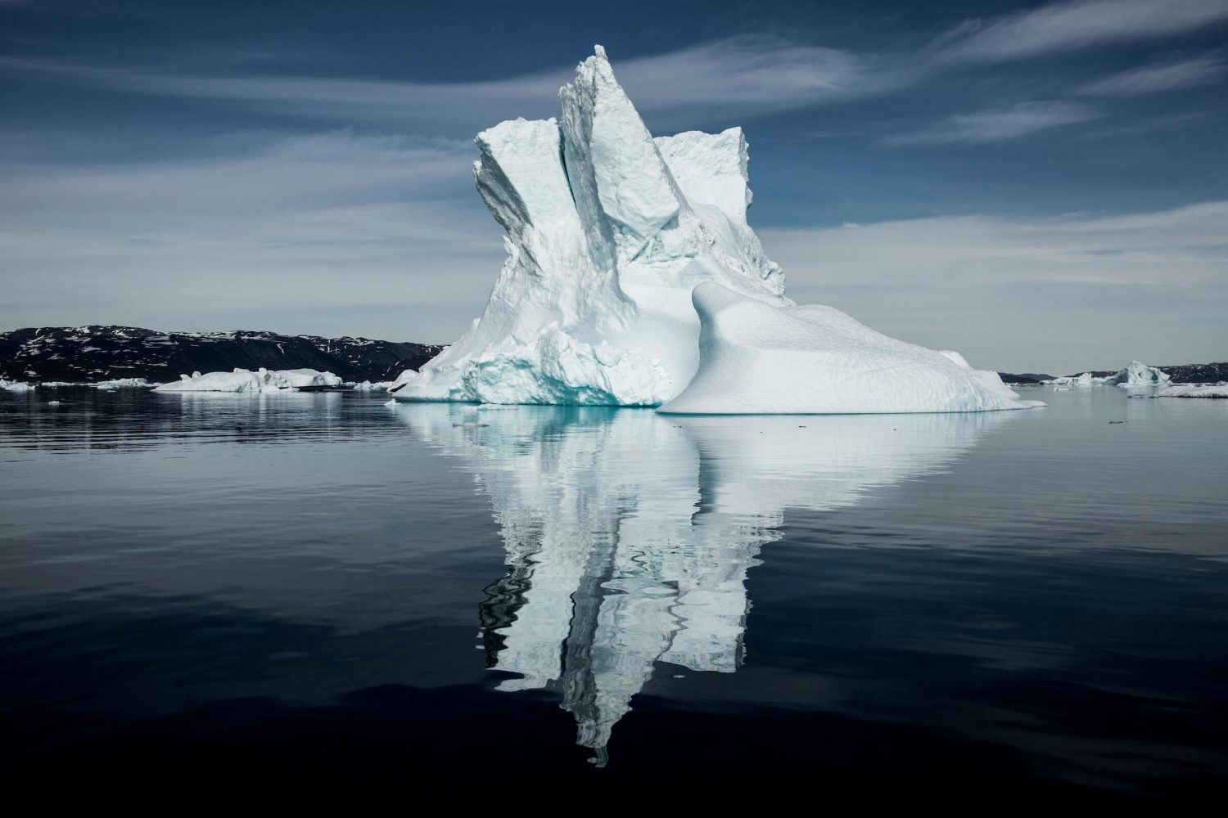
8 Key Trends
For Greenlandic operators to consider in a post-COVID world.

Slide 2
Dear Tourism Partner,
While the scope and impact of the COVID-19 pandemic is unprecedented, crises that impact the industry are not. After each crisis, values and attitudes shift, and these give way to new ways of doing doing things. After 9/11, we learned to accept stricter security at airports. After SARS, there was in increase in e-commerce.
How will our attitudes and values shift after this pandemic? And what does it mean for your business?
This document provides an overview of the scenarios we have forecasted for a return to normality in tourism and key trends that we expect to shape post-pandemic travel to Greenland and share some ideas about how you can adapt your product and marketing to be ready to welcome your guests when tourism starts up again.
June 2020
Notes:
Having a plan will help align the organization.

Slide 3
Key trends impact product, marketing or sometimes both
1. Online Experiences
7. Shifting Values
4. Increase in domestic tourism
PRODUCT
2. Health Checks
MARKETING
8. Distribution Shake-up
3. Social Distancing Tours
5. Higher Prices
6. Demographic shift

Slide 4
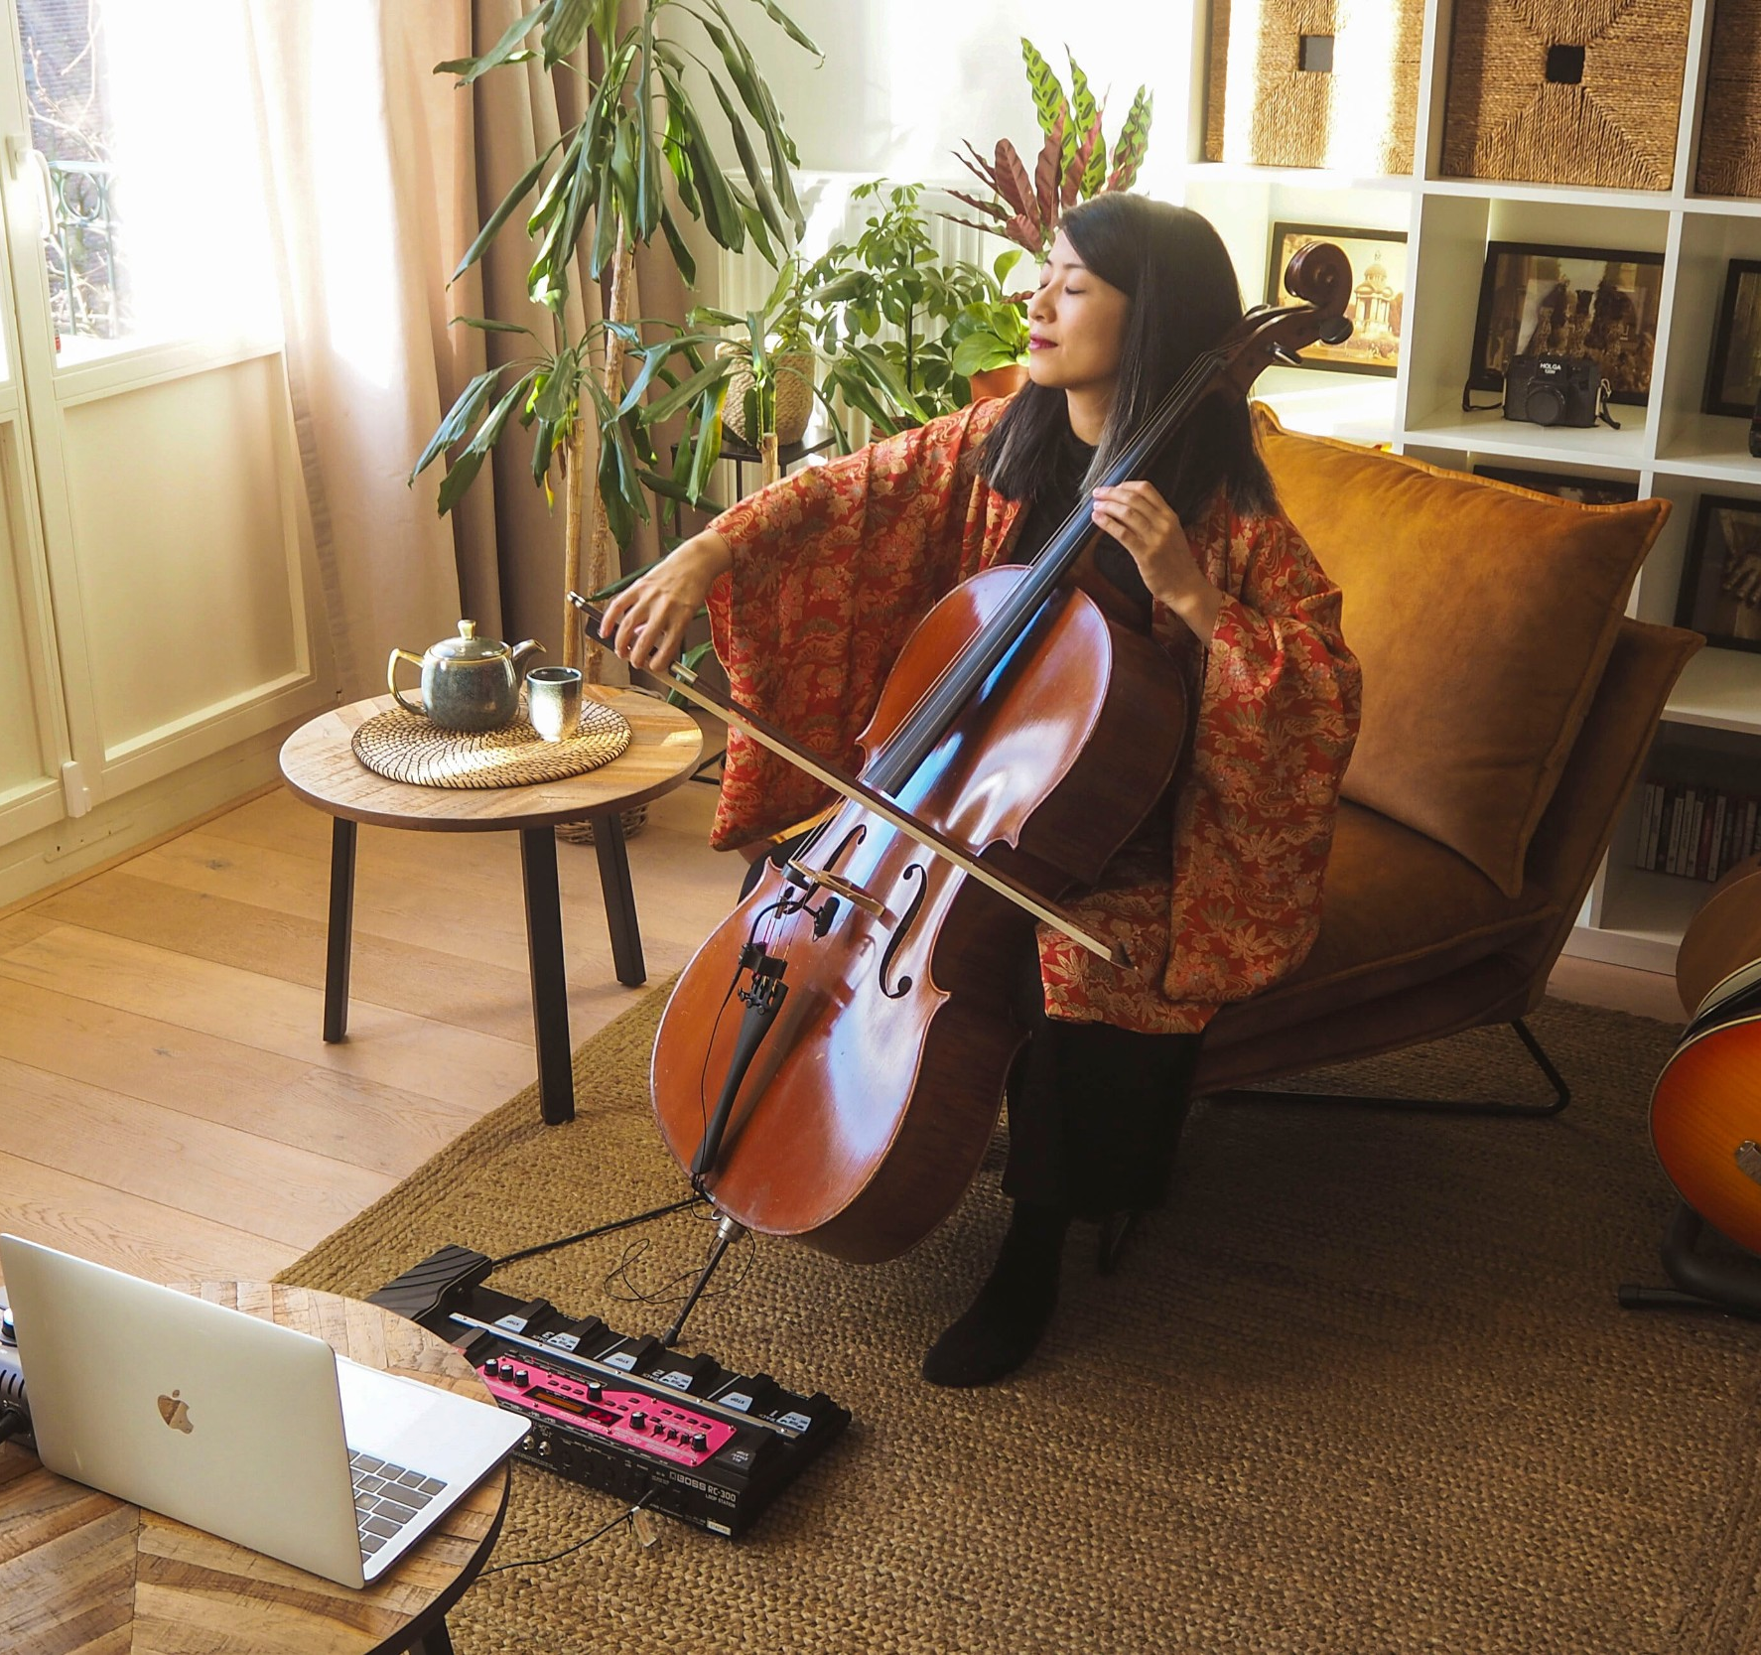
1. Online Experiences
While flights are still grounded, more and more people are turning to online platforms to explore the world.
What does this mean for me?
Consider if you have an experience that you can take online. A great story? A skill that can be taught online – cooking, crafts, sport, song? Can you adapt an existing tour to an online one? The following slide has a list of platforms that hosts tours. If you’re interested to list something online, review what’s been successful first. This blog post is useful for understanding what it takes to host a successful online experience.

Slide 5
Platforms Where You Can List Online Experiences
There are several platforms that allow you to list your online activities and charge. They take a commission.
Airbnb Online Experiences
Vacations with an Artist
Get Your Guide (’World At Home’)
With Locals
Viator
You could also offer online experiences through your own website, using your own payment portal or offering the experience for free as a marketing tool.

Slide 6
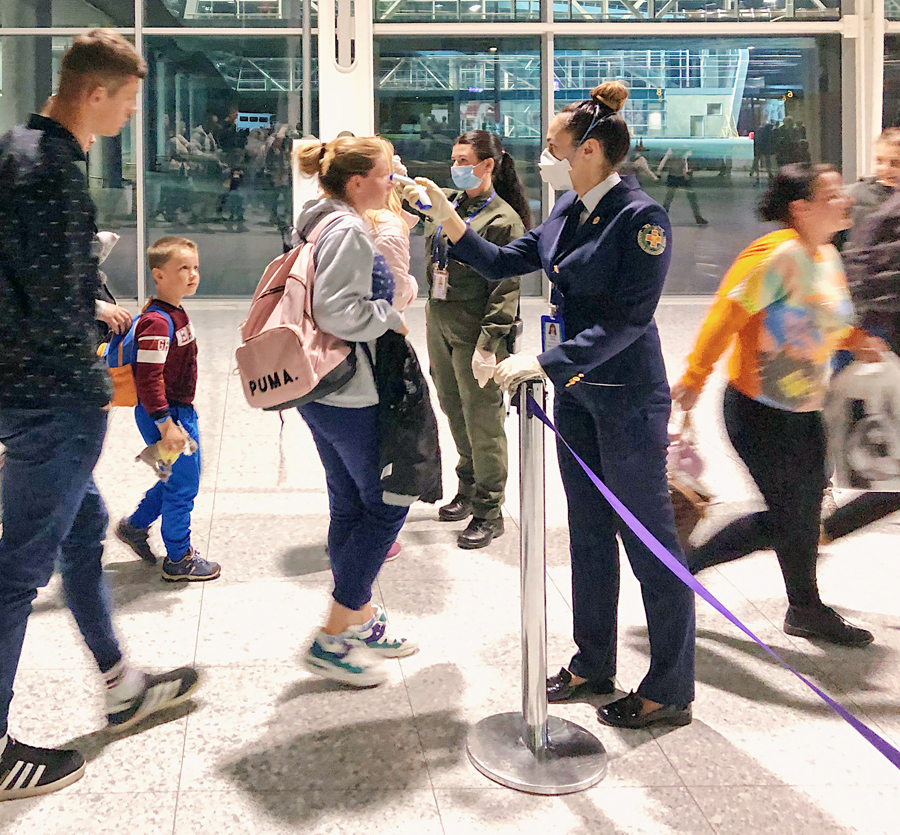
2. Health Checks
Guests will be checked through thermometers, health waivers and other mechanisms. In exchange, they will expect providers to have stringent hygiene protocols that keep them safe.
What does this mean for me?
This means companies hosting guests will need to create health guidelines that instill confidence in their guests and protect their employees. See the next slide for what that entails. Additionally, staff will be asked to stay home with even the slightest symptom. Employers will need to have on-call staff in the case of absence due to illness.

Slide 7
Create Guidelines to Protect Your Guests and Your Staff
Draft a health waiver (see next slide) that should be signed by guests
Create a document that outlines your preventative measures and record how they are adhered to. The document might include guidelines on :
  Temperature checks: guests and employees should be checked once a day.
  Hand-washing or hand-sanitizing requirements.
  Availability of masks or other personal protective equipment.
  Implementation of appropriate social distancing measures; especially consider any situations that might create queues and seating arrangements allow people to be 1.8 meters apart (Between household groups).
  Disinfecting any equipment and facilities on a daily basis; especially consider frequently touched things like doorknobs, keycards, front desks, car door handles etc. Airbnb has issued helpful guidelines that you may find useful.
  A protocol for handling a suspected infected guest; including an assigned quarantine area in your hotel/facility and ability to contact trace.
Assign a member of your team to internal auditor who is responsible for ensuring guidelines are being followed.
Train all staff on guidelines
Clearly communicate your health protocol with guests through posters, flyers or advance emails.
Interested in reading about guidelines in other countries? Get Your Guide has a useful summary.

Slide 8
Medical Waiver - Sample
This is an example of a type of waiver or declaration you might ask guests to sign pre-departure or on arrival (SEE NOTES FOR ADDITIONAL INFORMATION).
Due to the prevailing situation of outbreak of Novel coronavirus (2019-nCoV) and recommendations from the World Health Organisation (WHO), our guests must complete and sign the following waiver intended to protect the wellbeing of those guests and our local community
By signing this waiver you consent to; verification of 30 days past travel history, under-go brief temperature check prior to [entry to hotel / start of activity] and be attended to by a physician in the case of any symptoms resembling that of a cold, flu, fever or of other nature deemed to be assessed by the physician.
Failure to complete this form or adherence to aforementioned points, may result in [a cancelation of booking, refusal of boarding]. This questionnaire may be provided to local health authorities.
We thank you for your kind consideration and cooperation with these steps intended to ensure your stay is pleasant.
Please answer all questions:
Have you been to the countries below in the last 45 days: China / Italy / South Korea / Japan / France / Iran / USA → Yes /No
Prior to arrival in Greenland, have you had a COVID-19 test? Yes/No If yes, please state the date and the result.
Date of Arrival in Greenland
Since your arrival in Greenland, have you completed a quarantine period? If yes, where and for how long?
Are you currently experiencing any symptoms resembling the common cold (including but not limited to sinus congestion, fever, itching eyes, sore throat,) → Yes/No
Do You Consent TO:
Non-invasive temperature check? --> Yes/No
Follow basic rules to sterilise hands, footware and observe basic precautions during your stay? → Yes/No
At the decision of management, be attended by an physician? → Yes/No
Notes:
Note: In Greenland, this is provided by travelers to the Government (SUMUT Form). If the SUMUT form is not needed in Phase 3, but you’re keen to continue monitoring the past travels of your guests, you can consider this type of form. OR something similar can be used to inform your guests about the type of hygiene and health protocols that you’ll implement.

Slide 9
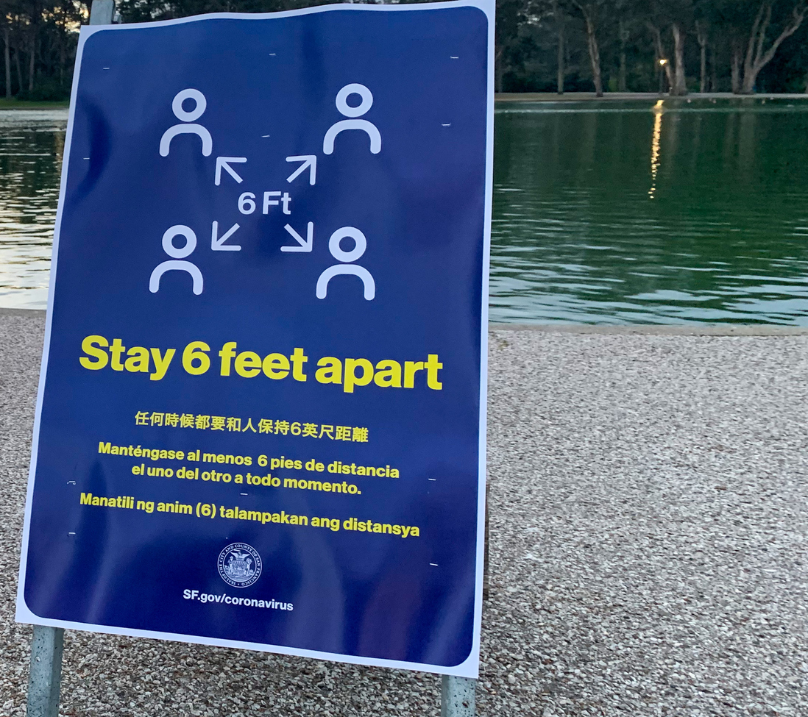
3. Desire to Maintain Social Distance
What does this mean for me?
Create packages that allow for private experiences - consider transportation, guiding and accommodation.
Initially, you may want to reduce or adapt community experiences like kaffemiks or visiting schools so everyone feels comfortable and safe.
If your itinerary has souvenir shopping or visits to places like museums, reach out to the owners and see if you can organize a dedicated time for your guests to be the only guests on the premises.
If you have a business where groups of strangers might be together (a store, a boat etc.) create a mechanism to ensure social distance, such as markers on the floor or empty middle seats.
To reduce fears of catching the virus, travelers will avoid big cities, large crowds, multiple transit stops and highly affected areas. They will prefer nature-based activities that allow them to properly social distance from others.

Slide 10
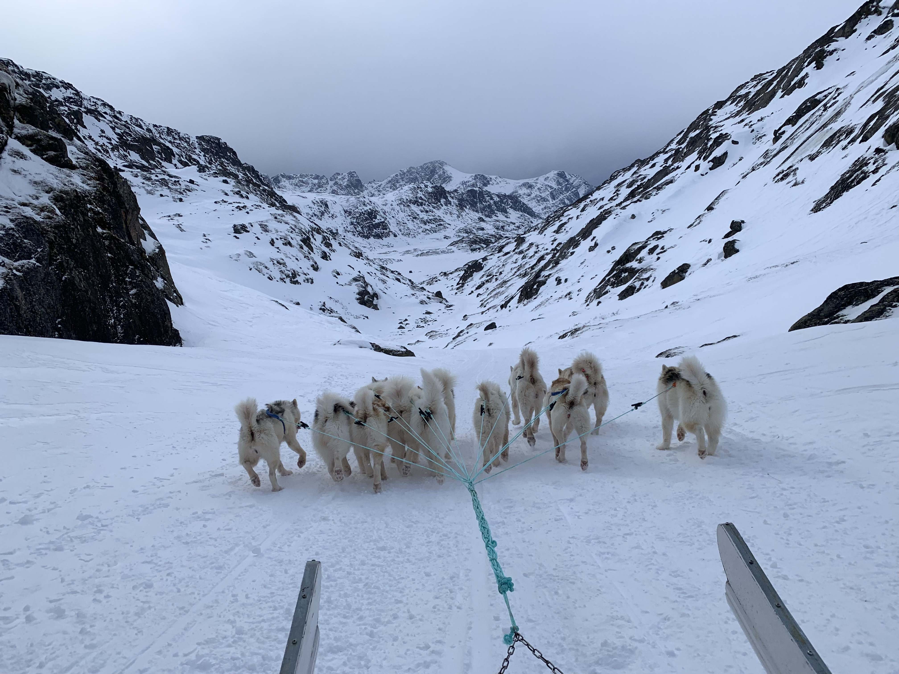
Example: What social distance might mean for a dog sled tour
Pick up guests at hotel, the car handle and other touchpoints has been cleaned since the previous guests.
The guests health waiver or declaration is shared by the hotel or the activity provider requires a new one be filled out.
Guests are given a health briefing by the guide in the lobby of the hotel at a safe distance (2 meters). They are informed that it is not possible to maintain a 2m distance from the dog-sled driver. They may be instructed to wear masks or face covering at all times and asked to wash their hands before they leave for the activity.
Guests do not shake hands with the guide.
Only household members can share a sled.
During the rest and snack time, disposable cups are used. Snacks, such as biscuits are individually wrapped and handed to guests.
Any loaned clothing (ie: snow suits) are washed at the highest temperature between guests. Given the cost of this, loaning clothing may now come at an extra charge.
Notes:
Note: in some activities, such as a dog sled ride, it is not possible to maintain the recommended distance. In this case, its simply important to inform them ahead of time so they know what to expect.

Slide 11
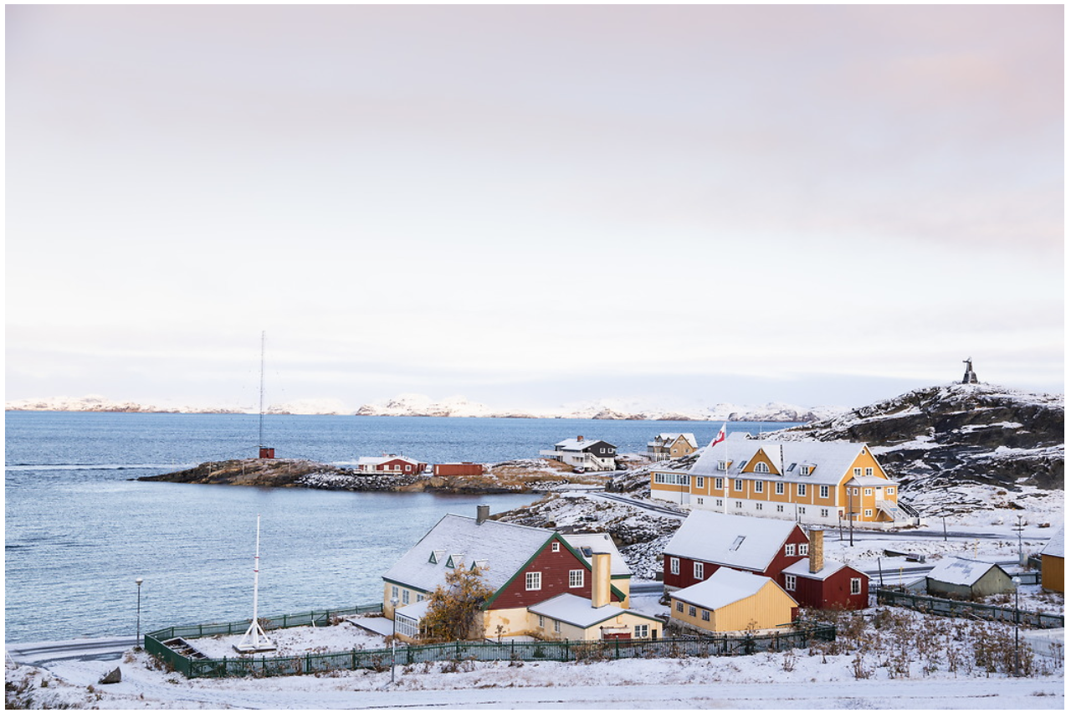
Example: What social distance might mean for a city tour
Where possible, conduct the city tour on foot – instead of in a bus.
Where possible, one guide per travelling group.
The guide carries hand-sanitizer and asks everyone to wear a mask for the tour.
Guide and guests stay 1.8 meters apart.
Shops and museums have slots for different groups to come in alone or they have a maximum capacity to ensure social distance, and may include markers on the floor to remind guests. Where possible, a one-way flow of guests is created.
Only contactless payment will be used in shop.
Hand sanitizer stations are available at each attraction.
No bathroom breaks in public areas, such as restaurants.
Some areas may be kept off-limits for tourists – such as super markets, fish markets etc. This would be the decision of the kommune, to reduce risk to elderly or at-risk populations.

Slide 12

4. Increase in Domestic Tourism
What does this mean for me?
This is both an opportunity and a risk. While only domestic travel is allowed, you have a captive market of Greenlandic and Danish tourists who aren’t able to travel elsewhere. On the other hand, once borders open, key source markets for Greenland will be actively promoting domestic tourism, capturing market share away from Greenland.
Actively market to domestic tourists through ‘staycation’ packages that target both the local (who live in the same town/region), domestic (who may require a domestic flight) and Danish, who are likely to be Greenland’s first market who don’t require a quarantine.
Also consider creating materials or packages for people who may hosts friends and relatives. Visiting Friends and Relatives (VFR) may be an important segment – and they can use guidance on what to do with guests, what packages are suitable, etc.
Due to budget constraints, closed borders and quarantine requirements – not to mention the uncertainty of implications of a second outbreak – many travelers may choose to stay close to home.

Slide 13
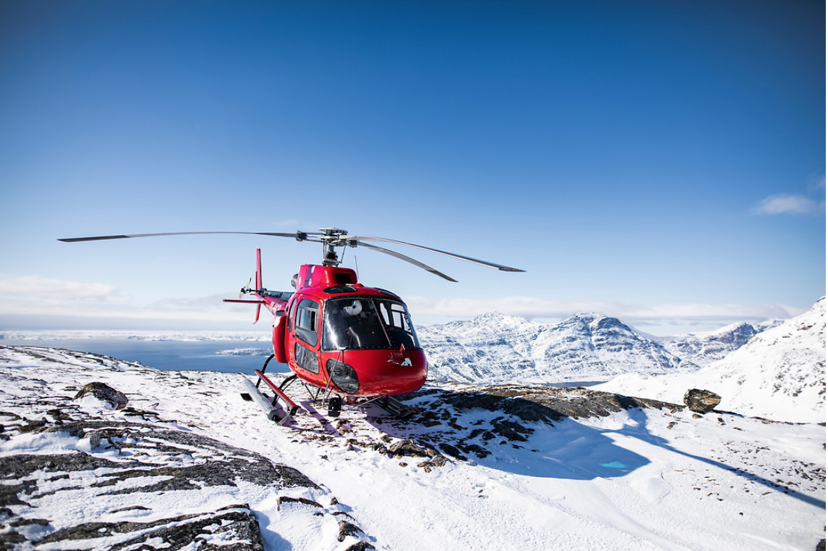
5. Higher Prices
What does this mean for me?
To compensate for higher airfares, travel companies will try to re-bound with a discount strategy on products and services, however this can start a race to the bottom. Besides reducing revenue, discounts diminish the perceived value of your service. Keep your prices and clearly articulate the value of your offer.
Driven by the increasing price of airfare, travel will become more expensive.

Slide 14
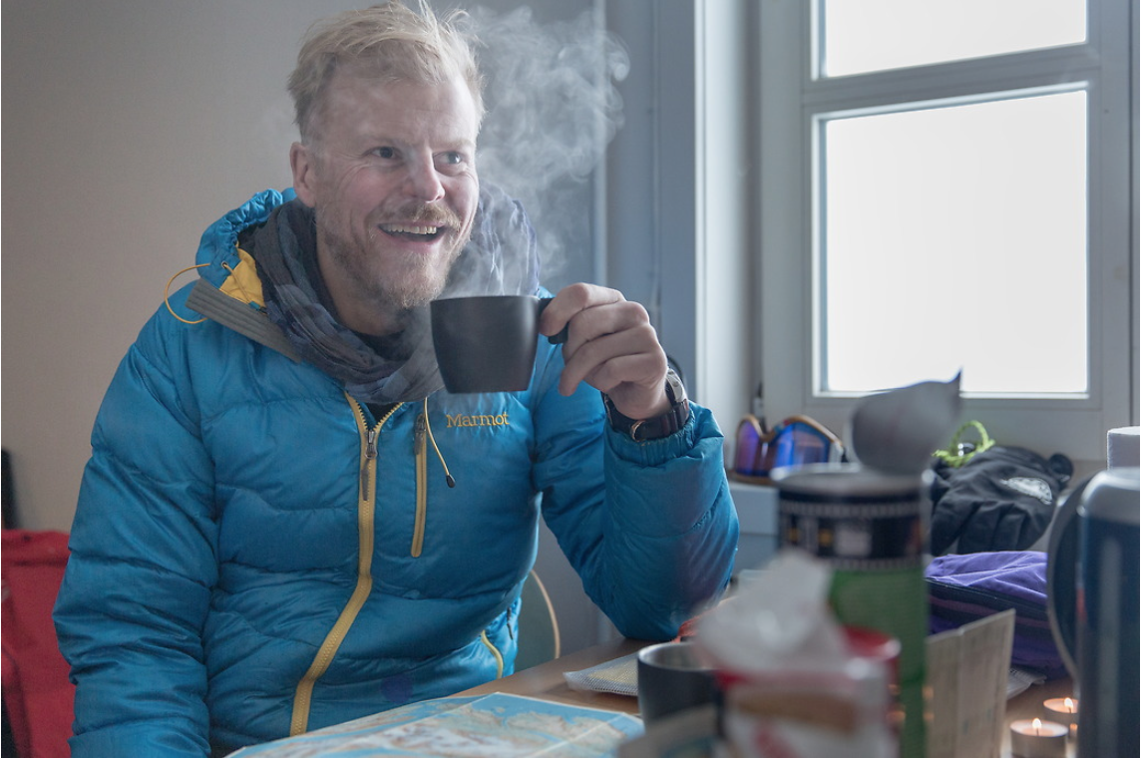
6. Demographic Shift
People over the age of 65 are considered a risk group for Covid-19. It is likely that older people will not travel despite all precautions.
Experts anticipate that Gen X and Gen Y will lead the tourism recovery, as they are old enough to have disposable income, but young enough to not be a risk group.
What does this mean for me?
If most of your clients are older, consider adapting your marketing and product to younger generations. Think about where they find their information and what they like to do.
If you have a direct to consumer approach, consider targeted content or advertising on social channels. If you have a B2B business model, work with your partners to focus on younger segments.

Slide 15

7. Values Shift
What does this mean for me?
More than ever, travelers will be looking at how companies reacted when the crisis hit and how they continue to operate in a global environment of uncertainty.
It is important that Greenland was lucky to have only eleven cases and that all recovered. Travelers will want to know that and will feel safe with that information. But that message needs to be delivered carefully and with empathy.
Consider other ways to show your empathy – like offering a special package for healthcare workers or first responders (Hospital and Hospitality share the same root afterall!).
Tourmageddon has published a helpful guide to marketing in the time of Corona.
In this difficult period, empathy, human connection and resilience are what got us through. Travelers will value companies that showed they cared through out the crisis and that continue to prioritize the well being of their employees and communities.

Slide 16

8. Distribution Shake-Up
During the pandemic, the weaknesses of the traditional travel distribution system have been revealed.
What does this mean for me?
You may want to evaluate your B2B partners, and consider where travelers will prefer to book in the future.
In this pandemic, many travel agents and outbound operators have shown their worth by supporting clients whose vacations were cancelled. Travelers will prefer to have a person they trust and can help them in an emergency, instead of the anonymity that comes with booking over an OTA.
On the other hand, some B2B partners may not survive the pandemic – especially those with high volume and low margins.
Notes:
During the pandemic, the weaknesses of the traditional travel distribution system have been revealed.

Slide 17
Contact: B2B@visitgreenland.com
Or Natasha Martin: natashamartin@gmail.com
June 2020

